Slide 1
Improving Classification Accuracy

Slide 2
What is meant by improving Precision
if there are 20 actual positive labels in the dataset and the model only classifies 10 of them correctly, the precision would be 10/10 + 10 = 10/20, which is 0.5 or 50%.
To increase precision, the goal would be to have the model correctly classify as many of the actual positive instances as possible. In this case, if the model could correctly identify all 20 out of 20 actual positive instances as positive, the precision would be 20/20 + 0 = 20/20, which is 1 or 100%.

Slide 3
Some techniques to improve accuracy and precision: Ensemble methods
An ensemble for classification is a composite model, made up of a combination of classifiers.
Uses combination of models to increase accuracy.
Bagging, boosting, and random forests are examples of ensemble methods

Slide 4
Some techniques to improve precision:
Bagging: Bagging (Bootstrap Aggregating) is a technique that involves training multiple models on different subsets of the training data and combining their predictions. To improve precision using bagging:

Slide 5
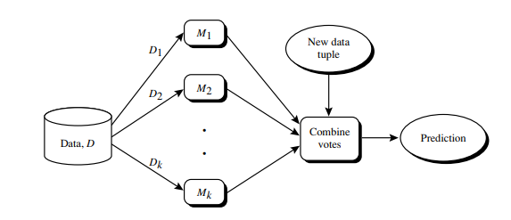
An ensemble combines a series of k learned models (or base classifiers), M1, M2,..., Mk , with the aim of creating an improved composite classification model, M∗

Slide 6
Bagging
Averaging the prediction over a collection of classifiers
Analogy: Diagnosis based on multiple doctor’s majority vote
Training, classification and prediction are three phases followed in this technique.
The bagged classifier often has significantly greater accuracy than a single classifier

Slide 7
Boosting
Analogy: Consult several doctors, based on a combination of weighted diagnoses—weight assigned based on the previous diagnosis accuracy.
Weights are assigned to each training tuple. A series of k classifiers is iteratively learned.
Comparing with bagging: Boosting tends to have greater accuracy, but it also risks overfitting the model to misclassified data.

Slide 8
Random forest
Each classifier in the ensemble is a decision tree classifier and is generated using a random selection of attributes at each node to determine the split.
During classification, each tree votes and the most popular class is returned.
Two Methods to construct Random Forest: Forest-RI (random input selection)
Forest-RC (random linear combinations)
Insensitive to the number of attributes selected for consideration at each split, and faster than bagging or boosting

Slide 9
Improving accuracy vs precision
Increasing accuracy generally involves improving the overall correctness of predictions, including both true positives and true negatives.
On the other hand, increasing precision focuses specifically on improving the model's ability to correctly identify positive instances.
The choice between giving more importance to precision or overall accuracy depends on the specific problem
Precision more important :In some cases, precision may be more critical, such as in medical diagnoses where false positives (Type I errors) can have severe consequences.
Accuracy more important : Email spam and non spam classification.
Increasing the precision is more chosen where the maximizing the true positives and reducing the false positives Is more important .
Increasing the total accuracy is chosen where classifying true positives and true negatives and eliminating the false positives and false negatives is given equal importance so as to.

Slide 10
What is required to make use of these techniques?
Labeled Training Data: Sufficient labeled data is necessary to train and evaluate the binary classifier.
Evaluation Metrics: Utilize appropriate evaluation metrics to assess the performance of the binary classifier.

Slide 11
Issues can arise when using these techniques
Overfitting
Class-imbalance problem: Rare positive example but numerous negative ones, e.g., medical diagnosis, fraud, oil-spill, fault, etc
Both boosting and bagging require training multiple models, which can be computationally expensive, especially if the dataset is large or the base models are complex.
Traditional methods assume a balanced distribution of classes and equal error costs: not suitable for class-imbalanced data
Typical methods for imbalance data in 2-class classification: Oversampling, Undersampling and Threshold-moving

Slide 12
For example, if precision is more important, you can increase the threshold to make the model more conservative in labeling instances as positive, leading to a higher precision but possibly lower recall. On the other hand, if recall is prioritized, you can decrease the threshold to capture more positive instances, potentially sacrificing precision.
The process of threshold moving involves evaluating the model's performance at different threshold values and selecting the optimal threshold that aligns with the desired balance between precision and recall, or any other relevant metrics based on the problem at hand.

